Slide 1


Deploying Elasticsearch on kubernetes(K8s) Abednego Audu Cloud DevOps Engineer 16/05/2022

Slide 2
Project Highlights
Benefits of Elasticsearch
Solution Architecture
Elasticsearch deployment
Kibana deployment
Link to Readme.md

Slide 3
Benefits of Elasticsearch
Open source
Fast performance
Scalability
Distributed Architecture
Document-oriented Nosql Database
Schema free
Auto-completion
Notes:
Speed and Simplicity: IAC allows you to spin up an entire infrastructure architecture by running script.
Configuration consistency: Standard operating procedure can help maintain some consistency in the infrastructure deployment process. IAC completely standardized the setup infrastructure so there is reduces possibility of any errors or deviation.
Increased Efficiency in SD: Developer productivity drastically increases with the use of IaC. Cloud architectures can be easily deployed in multiple stages to make the software development life cycle much more efficient.

Slide 4
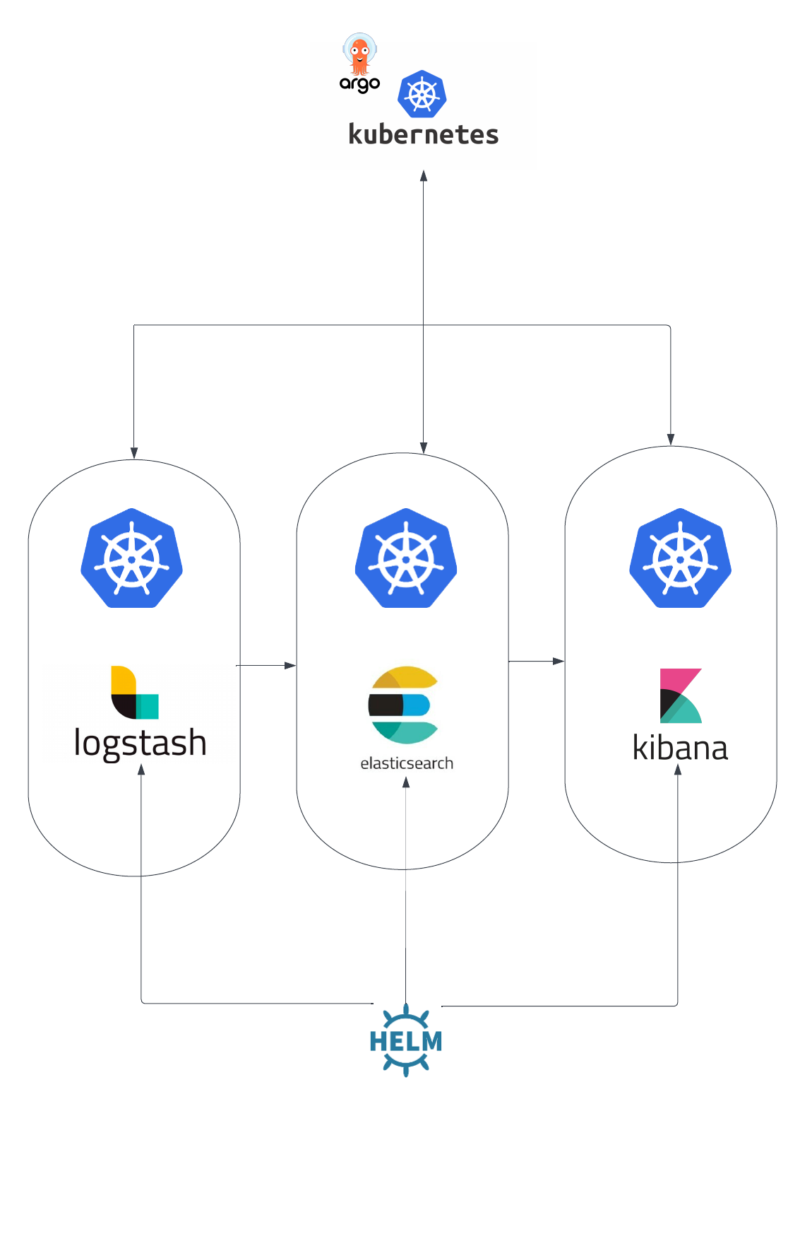


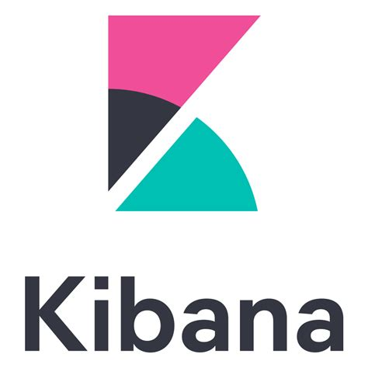
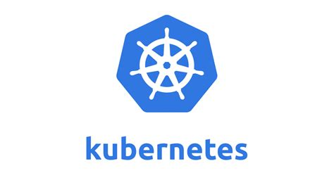



Architecture
TOOLS

Slide 5

ES Deployment

Slide 6
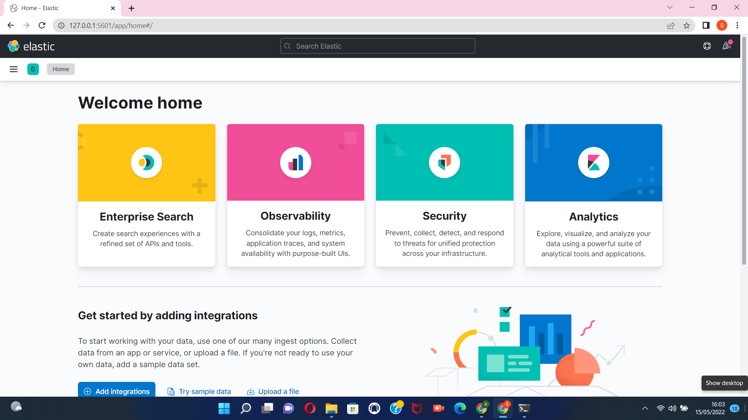
Kibana Deployment

Slide 7
Link to README.md
https://github.com/AAudu04/Picnic-Home-Assignment#readme

